Slide 2

Community-led delivery of HIV self-testing targeting adolescents and men in rural Malawi: a cluster-randomised trial
Pitchaya Indravudh
Notes:
Early findings from a CRT of community-led delivery of HIVST in rural Malawi

Slide 3
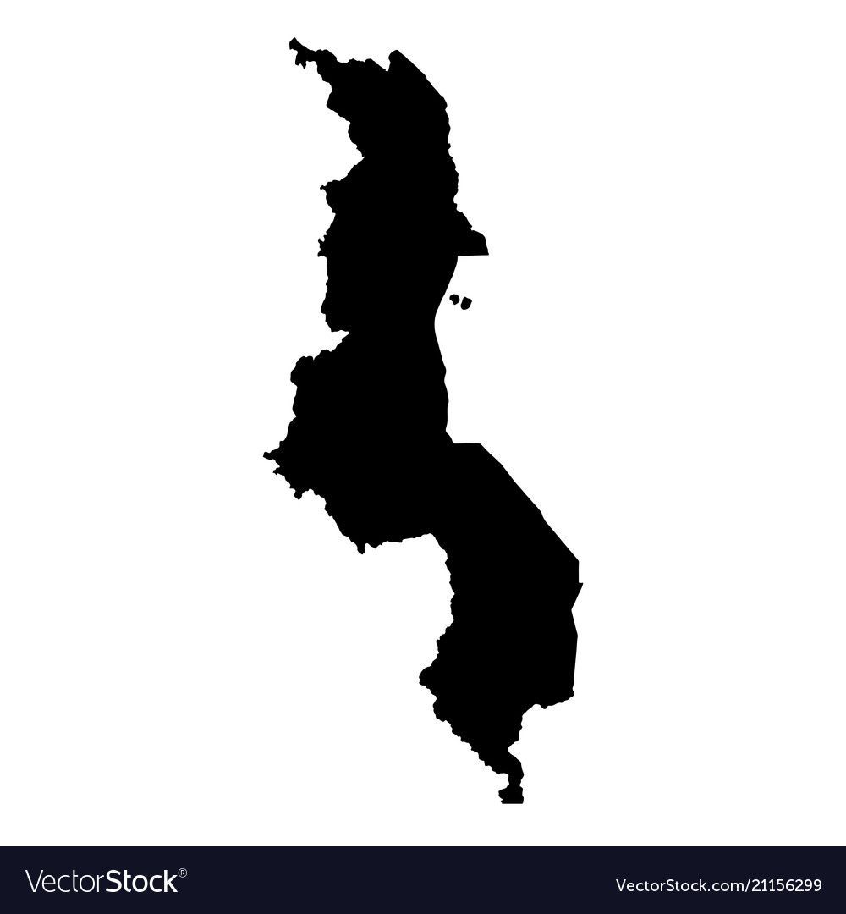

HIV epidemic in Malawi
9.6%
90%
90%
71%
adult HIV
prevalence in
Malawi
61%
.15
2
to
million Malawians tested from
’00-’15
Diagnosed
On ART
Virally suppressed
Malawi MoH 2016; UNAIDS 2018
Notes:
HIV prevalence in Malawi among highest in world; 9.6% of adults living with HIV
In response to epidemic → MoH scaled-up testing and treatment programs through facility-based and periodic CB services
As a result →
Significant declines in HIV incidence in past decade
Malawi has met 'first 90’ → remaining gap in knowledge of status stemming from populations with barriers to accessing HIV services (men, adolescents, older adults)

Slide 4

Community-based HIV testing
Community-based
Community-led
?
Sharma 2015, Hayes 2019: Improved testing in low-coverage populations, early detection of HIV-positives, reduced HIV incidence
Choko 2015: High uptake of CB-HIVST in adolescents and men
Indravudh 2018: CB-HIVST increased testing, no differences in effect by age and sex; no effect on ART initiation
Notes:
CB HIV testing strategies can contribute to increased testing in low-coverage sub-groups, early detection of HIV positives, reduced HIV incidence
CB-HIVST strategies also show promise → including from studies in Malawi conducted by our team
Despite evidence → CB strategies are resource intensive, costly, not widely implemented
Current trial → aim to build on promise of CB-HIVST and evaluate effectiveness and costs of CL approach

Slide 5
Community-led HIV self-testing?
Community-led involves supporting communities to identify health problems, plan and implement solutions to improve health, and evaluate solutions
Previous evaluations of community-led interventions in onchocerciasis, dengue, HIV, maternal and child health, and sanitation, with evidence of improved health outcomes
Why community-led delivery of HIVST?
  Increase coverage of HIV testing in adolescents, men and older adults
  Address resource limitations required for community-based services
  Engage communities in HIV prevention
Can community-led delivery of HIV self-testing improve uptake of HIV
testing, ART initiation and broader social outcomes in rural Malawi?
Notes:
Community-led approach often involves supporting communities to:
Develop knowledge/skills to identify problems contributing to poor health
Plan/implement solutions to improve health
Evaluate implementation of solutions
Previous evaluations of community-led interventions have been conducted across multiple disease areas, with evidence of improved health outcomes
Our study → aims to:
Apply CL approach to HIV prevention using HIVST
Address implementation gaps in national HIV programme:
Low coverage of HIV testing in underserved sub-groups
Resource limitations required for CB strategies
Lack of engagement of communities in HIV prevention
Guided by overall RQ: Can CL delivery of HIVST improve uptake of HIV testing, ART initiation and broader social outcomes in rural Malawi?

Slide 6
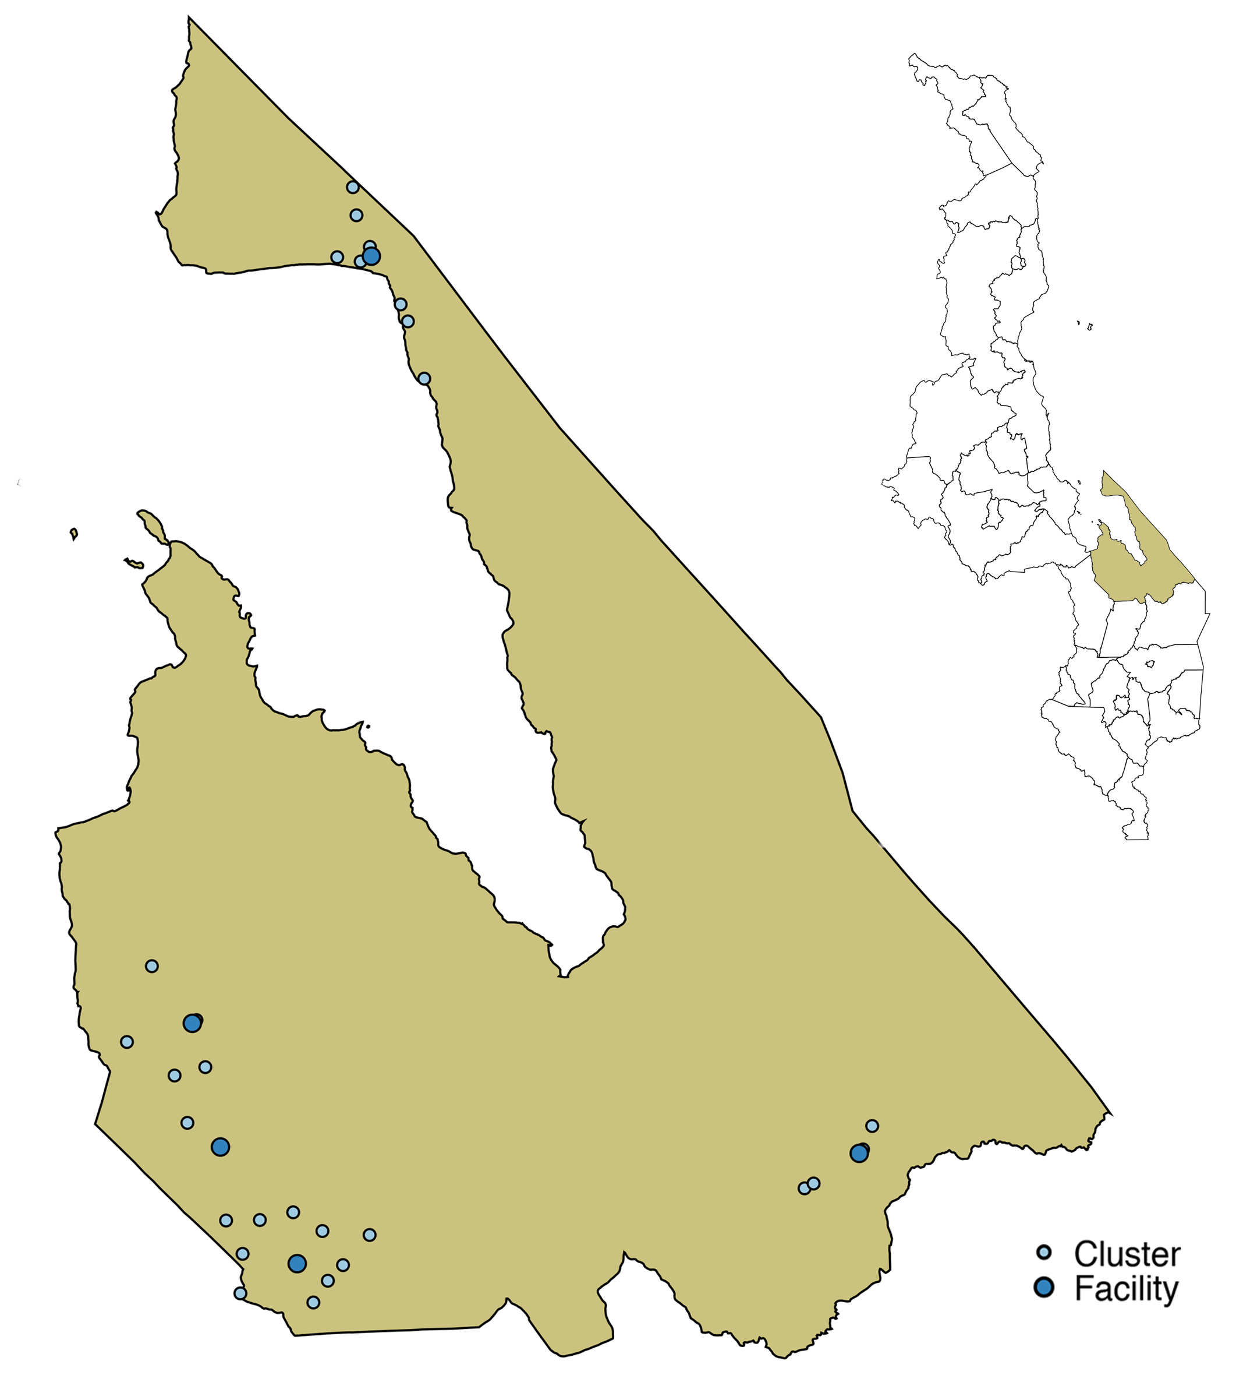
Trial design
30 GVH-defined clusters eligible for randomisation
Intervention arm
15 GVHs allocated to CL-HIVST
Communities supported to plan and implement HIVST campaign linked to HIV treatment and prevention.
Control arm
15 GVHs allocated to SOC
Continuation of MOH SOC, with HIV services provided through health facilities and community outreach.
Oct. 2018-Jan. 2019
Primary outcome: Lifetime HIV testing in adolescents 15-19 years
Secondary outcome:
Testing in the last 3 months in adults ≥ 40 years
Testing in the last 3 months in men
Cumulative incidence of ART initiation across 6 months
Measure of knowledge of HIV prevention
Measure of HIV testing stigma
Outcome measurement
Cross-sectional surveys at 8-12 weeks
Clinic data capture for 6 months
Dec. 2018-Jul. 2019
Notes:
Mangochi district (PEPFAR priority district; intensive HIV programmes)
Areas organized by traditional chieftaincy systems
Primarily GVHs → oversee groups of villages
30 GVHs randomized to intervention or control arm
Intervention → Communities supported to plan and implement HIVST campaign linked to HIV treatment and prevention
Control → Communities continue with MOH SOC (facility-based and periodic CB HIV services)
Primary outcome → lifetime testing in adolescents
Secondary outcomes
Recent testing in men and adults 40+
ART initiation
Knowledge of HIV prevention
HIV testing stigma
Outcomes measured through post-intervention surveys (8-12 weeks) and clinic data capture (6 months)
Implementation started in Oct. 2018
Survey completed in Mar. 2019
Clinic data collection to end this month

Slide 7



Project team
Notes:
Trial part of a portfolio of studies under STAR consortium
Implementation partners in Malawi → LSHTM, MLW, PSI

Slide 8
Intervention design
2-day workshop with community health action groups
2-day training with community volunteers
Material inputs
Understand drivers of HIV infection, including barriers to service utilisation
Define underserved sub-groups
Plan HIVST campaign, including: sensitisation, distribution of HIVST kits, linkage to treatment and prevention, HIV prevention messages, monitoring & evaluation
Develop competency to promote and support HIVST services, including: pre-test information, post-test support, social harms monitoring, data capture
Finalise HIVST campaign plan
HIVST kits
Informational materials
Data capture tools
US$10 gratuity
7-day HIVST campaign linked to HIV care and prevention delivered by community health action groups and community volunteers
Notes:
Point of contact in community → informal community health cadres including
CHAGs → represent health issues at GVH-level
CHVs → deliver community health services with oversight by CHAGs
Intervention consists of 3 components:
2-day participatory workshops with CHAGs
Decide how, where and when kits will be distributed and to whom
Decide how linkage to treatment/prevention, HIV prevention messages, and M&E will be provided
2-day trainings with CHVs on how to promote and support HIVST
Provided material inputs, including kits, informational materials, data capture tools, $10 gratuity (nationally standardized)
HIVST campaigns delivered by CHAGs and CHVs across 7-days (length of typical MOH testing campaign)

Slide 9
CONSORT diagram
30 GVH-defined clusters randomised
15 GVHs received CL-HIVST
30374 total adults ≥ 15 years
15 GVHs received SOC
25585 total adults ≥ 15 years
2150 households enumerated
2036 households (94.7%) responded
2160 households enumerated
2072 households (95.9%) responded
4365 adults ≥ 15 years eligible
3958 adults (90.7%) completed survey and included in analysis
4354 adults ≥ 15 years eligible
3896 adults (89.5%) completed survey and included in analysis
1015 adolescents 15-19 years eligible
928 adolescents (91.4%) completed survey and included in analysis
1019 adolescents 15-19 years eligible
886 adolescents (86.9%) completed survey and included in analysis
Notes:
Intervention was delivered across study catchment population of 30,000
Evaluation areas were selected in each cluster
Sampled population: 4,300 in each arm
High response rates overall and among adolescents (primary outcome)

Slide 10
Sample characteristics
 | HIVST (N=3974) | SOC (N=3906)
Age group (no/%)
15-19 years | 914 (23%) | 863 (22.1%)
20-24 years | 633 (15.9%) | 673 (17.2%)
25-39 years | 1253 (31.5%) | 1267 (32.4%)
≥40 years | 1174 (29.5%) | 1103 (28.2%)
Male (no/%) | 1584 (39.9%) | 1488 (38.1%)
Never married (no/%) | 922 (23.2%) | 906 (23.2%)
Education (no/%)
None | 1732 (43.6%) | 1762 (45.1%)
Primary | 1914 (48.2%) | 1826 (46.8%)
Secondary or higher | 328 (8.3%) | 317 (8.1%)
Household wealth - quintiles (no/%)
Highest | 686 (18.1%) | 632 (17.2%)
Second | 626 (16.6%) | 662 (18%)
Third | 725 (19.2%) | 719 (19.5%)
Fourth | 793 (21%) | 849 (23%)
Lowest | 952 (25.2%) | 823 (22.3%)
Notes:
Characteristics of survey respondents
Adolescents → quarter of respondents; men → 40% of respondents
Most respondents married; no or primary level education

Slide 11
Uptake of HIVST in intervention arm
Routine data: 15 CHAGs oversaw distribution of 24,347 kits by 188 CHVs
Post-intervention survey: 74.4% (2956/3973) ever self-tested
  2.4% (70/2951) tested positive
    37.3% (25/67) linked to confirmatory testing
    84.0% (21/25) started on ART
  0.4% (12/2943) pressured to self-test
  0.0% (7/2943) pressured to disclose self-test result
N=24,347
Notes:
Describes HIVST implementation and uptake
15 CHAGs oversaw distribution of 24,367 kits by 188 CHVs over a 1-week period
Self-testers → half were men; quarter were adolescents; 20% were adults 40+
Quarter were first-time testers
Distribution mode → most kits directly distributed to recipient and were provided door-to-door
Based on household survey
HIVST uptake → 75% in intervention arm
Of those who self-tested, positivity and linkage to care rates were low
Social harms (pressure to self-test/disclose results) close to none

Slide 12
Primary outcome: lifetime testing in adolescents
 | HIVST | SOC | Risk Difference (95% CI), p-value | Unadj Risk Ratio (95% CI), p-value | Adj Risk Ratio¹ (95% CI), p-value
 | % (n/N) | % (n/N)
Lifetime testing in adolescents | 84.6% (773/914) | 67.1% (579/863) | 16.4% (7.8-25.0%), <0.001 | 1.26 (1.11-1.43), <0.001 | 1.25 (1.10-1.43), 0.001
Stratified by age
15-17 years | 79.8% (320/401) | 57.2% (219/383) | 22.3% (9.6-35.1%), 0.001 | 1.46 (1.15-1.86), 0.003 | 1.45 (1.14-1.85), 0.004
18-19 years | 88.3% (453/513) | 75.0% (360/480) | 11.7% (4.5-18.9%), 0.002 | 1.16 (1.06-1.27), 0.002 | 1.16 (1.05-1.27), 0.004
P-value for interaction |  |  |  |  | 0.02
Stratified by sex
Boys | 79.7% (310/389) | 57.3% (217/379) | 22.6% (12.1-33.1%), <0.001 | 1.42 (1.19-1.68), <0.001 | 1.40 (1.18-1.67), <0.001
Girls | 88.2% (463/525) | 74.8% (362/484) | 11.9% (2.8-21.0%), 0.01 | 1.18 (1.04-1.33), 0.01 | 1.18 (1.03-1.33), 0.01
P-value for interaction |  |  |  |  | 0.01
¹ Adjusted for age, sex, educational attainment and marital status. Sub-group analysis by age group not adjusted for
age. Sub-group analysis by sex not adjusted for sex.
Notes:
Results of cluster-level analysis for primary outcome → lifetime testing in adolescents
RD, RR, aRR
Increase in lifetime testing in adolescents, with higher proportion testing in HIVST vs SOC arm
Sub-group analysis of primary outcome
Evidence that the effect of the intervention differed by age and sex
Higher effect in younger adolescents and boys

Slide 13
Secondary outcomes
 | HIVST | SOC | Risk Difference (95% CI), p-value | Unadj Risk Ratio (95% CI), p-value | Adj Risk Ratio¹ (95% CI), p-value
 | % (n/N) | % (n/N)
Testing in last 3 months
Adults ≥40 years | 74.5% (1180/1584) | 33.9% (504/1488) | 40.7% (33.1-48.4%), <0.001 | 2.22 (1.92-2.56), <0.001 | 2.21 (1.92-2.55), <0.001
Men | 74.2% (871/1174) | 31.6% (348/1103) | 42.0% (34.5-49.5%), <0.001 | 2.36 (1.99-2.80), <0.001 | 2.37 (2.00-2.80), <0.001
Knowledge of HIV status in partners | 71.3% (2056/2882) | 56.9% (1660/2919) | 14.5% (8.4-20.5%), <0.001 | 1.26 (1.14-1.39), <0.001 | 1.24 (1.08-1.42), 0.003
 | HIVST | SOC | Mean Difference (95% CI), p-value
 | GM | GM
Knowledge of HIV prevention (TasP)² | 15.0 | 14.7 | 0.30 (-0.66-1.25), 0.53
HIV testing stigma³ | 7.37 | 7.56 | -0.18 (-0.57-0.21), 0.35
¹ Adjusted for age, sex, educational attainment and marital status
² 5 Qs at 5-point scale; 5 to 25 (low to high knowledge)
³ 6 Qs at 3-point scale; 3 to 18 (low to high stigma)
GM, geometric mean
Notes:
In terms of secondary outcomes…
Increase in testing in last 3 months in both older adults and men
Not presented here: significant effect when testing period is extended to last 12 months and lifetime testing
Knowledge of HIV status within sexual partners higher in HIVST vs SOC arm
Intervention had no significant effect on knowledge of HIV prevention and HIV testing stigma

Slide 14
Limitations
SOC arm was defined by standard HIV services provided by the Ministry of Health, rather than parallel community-based testing campaigns
  However, Mangochi is a PEPFAR priority district with ongoing community-based testing
No adjustment for cluster-level differences at baseline
Unable to evaluate unpaid delivery by communities
No evaluation of accuracy
Results on population-level ART initiation and cost-effectiveness not yet available
Notes:
Number of limitations…
SOC defined by standard MOH HIV services rather than parallel community-based testing
However, ongoing community-based testing in SOC
No baseline survey → unable to adjust for cluster-level differences
Unable to evaluate unpaid delivery by communities → MoH standard practice including gratuity for volunteers
No evaluation of accuracy but high sensitivity/specificity demonstrated in previous studies
Results on impact on ART initiation and cost-effectiveness not yet available

Slide 15
Conclusions
High HIVST uptake (74.4%) compared to other CB-HIVST approaches reported thus far
Significant increase in lifetime testing among adolescents, recent testing in adults ≥ 40 years and men, knowledge of HIV status within couples
  No impact on knowledge of HIV prevention or HIV testing stigma
Minimal social harms
Low yield and linkage to care
Policy makers can consider this approach to rapidly achieve high knowledge of HIV status in remote communities
  Once-off or periodic campaigns
  Communities with high undiagnosed HIV
Notes:
Intervention evaluated → included engaging established community health structures to deliver one-week HIVST campaign linked to HIV treatment and prevention
Results highly promising, with 75% uptake of HIVST
Compared to our previous evaluation of CB-HIVST → 40% uptake
Intervention resulted in a significant increase in lifetime testing among adolescents, recent testing in adults 40+, men, and knowledge of HIV status within couples
No impact on knowledge of HIV prevention or HIV testing stigma
Reflects short period of intervention
Minimal social harms
Positivity and linkage rates were low (room to consider how communities can better support linkage)
Policy makers can consider this approach to rapidly achieve high community-level knowledge of status in remote communities, either →
Once-off or periodic campaigns (2-5 years)
Communities with high undiagnosed HIV and ongoing need for HIV prevention

Slide 16
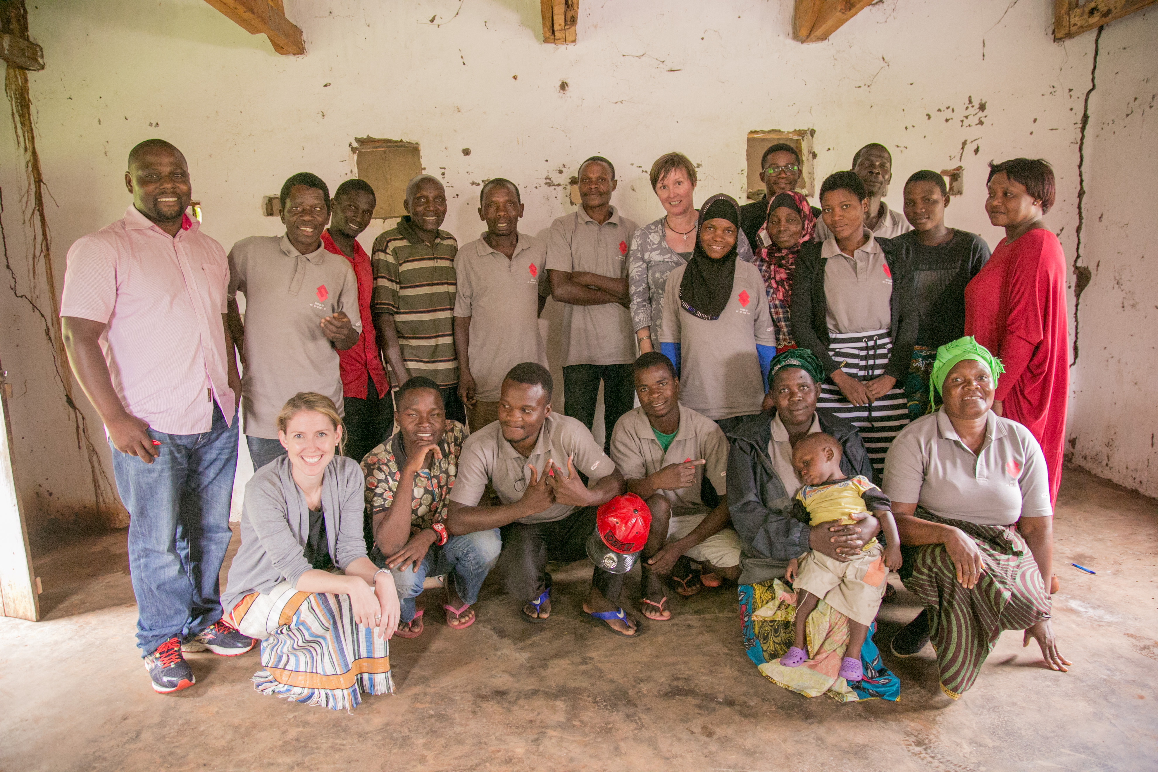

Acknowledgments
MLW: Moses Kumwenda, Rebecca Nzawa
PSI: Richard Chilongosi, Karin Hatzold
LSHTM: Katherine Fielding, Fern Terris-Prestholt, Liz Corbett
LSTM: Nicola Desmond
Ministry of Health: Rose Nyirenda
WHO: Cheryl Johnson, Rachel Baggaley
Study participants
Unitaid

Slide 17
Contact
Pitchaya Indravudh
Research Fellow, London School of Hygiene and Tropical Medicine
pitchaya.indravudh@lshtm.ac.uk

Slide 18
No competing interests to declare

